Slide 1

웹 프로그래밍
한글과컴퓨터학원
조교 이서현

Slide 2
blog
helloworld/blog/views.py
class CommentAdd(CreateView): model = Comment fields = ['writer', 'content', 'post'] def get_success_url(self): return reverse('blog:post_detail', kwargs={'slug': self.object.post.slug})

Slide 3
blog
helloworld/blog/urls.py
path('comment/', views.CommentAdd.as_view(), name='comment'),

Slide 4
blog
helloworld/blog/views.py
class CommentAdd(CreateView): model = Comment fields = ['writer', 'content', 'post'] def get_success_url(self): return reverse('blog:post_detail', kwargs={'slug': self.object.post.slug})

Slide 5
blog
helloworld/blog/templates/blog/post_detail.html
<form action="{% url 'blog:comment' %}" method="post"> {% csrf_token %} <input type="hidden" name="post" value="{{post.id}}"> <input type="text" name="writer" placeholder="작성자"> <textarea name="content" placeholder="내용"></textarea> <input type="submit" value="댓글작성"> </form>

Slide 6
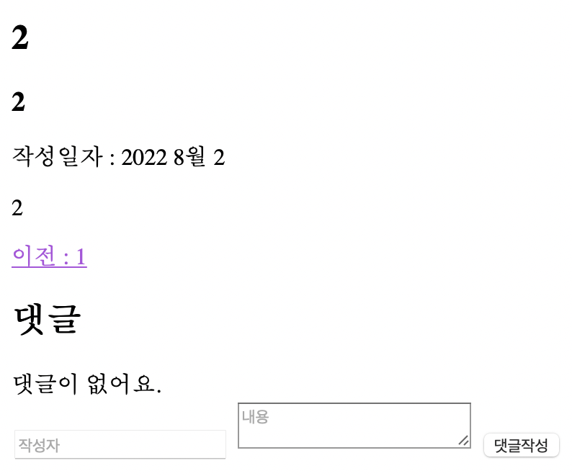
blog
localhost/blog/post

Slide 7
blog
helloworld/blog/models.py
from django.utils.text import slugify class Post(models.Model):
def save(self, force_insert=False, force_update=False, using=None, update_fields=None): self.slug = slugify(self.title, allow_unicode=True) super().save(force_insert, force_update, using, update_fields)

Slide 8
blog
helloworld/blog/urls.py
path('post/', views.PostAdd.as_view(), name='post'),

Slide 9
blog
helloworld/blog/views.py
class PostAdd(CreateView): model = Post template_name = 'blog/post_write.html' fields = ['title', 'content', 'description'] def get_success_url(self): return reverse('blog:post_detail', kwargs={'slug': self.object.slug})

Slide 10
blog
helloworld/blog/templates/blog/post_list.html
<h1>게시물<a href="{% url 'blog:post' %}">새 글 작성하기</a></h1>

Slide 11
blog
helloworld/blog/templates/blog/post_write.html
<h1>새 글 작성하기</h1> <form action="{% url 'blog:post' %}" method="post"> {% csrf_token %} <input type="text" name="title" placeholder="제목" value=""> <input type="text" name="description" placeholder="설명" value=""> <textarea name="content" placeholder="내용"></textarea> <input type="submit" value="작성"/> </form>

Slide 12
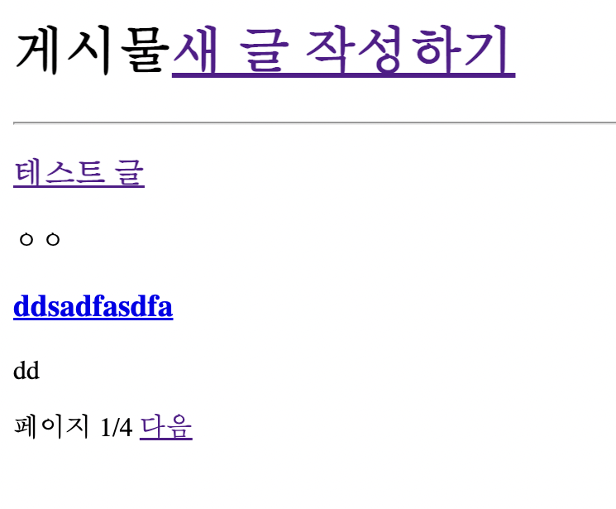
blog
localhost/blog

Slide 13
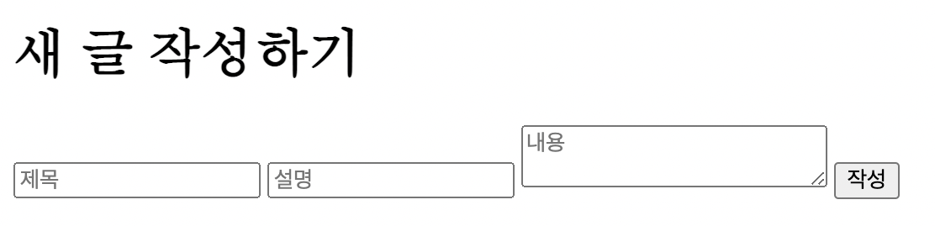
blog
localhost/blog/post

Slide 14
blog
helloworld/blog/views.py
class PostLV(ListView):
def get_queryset(self, *args, **kwargs): qs = super().get_queryset(*args, **kwargs) query = self.request.GET.get('q') if query: return qs.filter(title__contains=query) return qs

Slide 15
blog
helloworld/blog/views.py
class PostLV(ListView):
def get_context_data(self, **kwargs): context = super(PostLV, self).get_context_data(**kwargs) if self.request.GET.get('q'): context['q'] = self.request.GET.get('q') return context

Slide 16
blog
helloworld/blog/templates/blog/post_list.html
<form method="get"> <input type="text" name="q" value="{{q}}"> <input type="submit" value="검색"> </form>

Slide 17
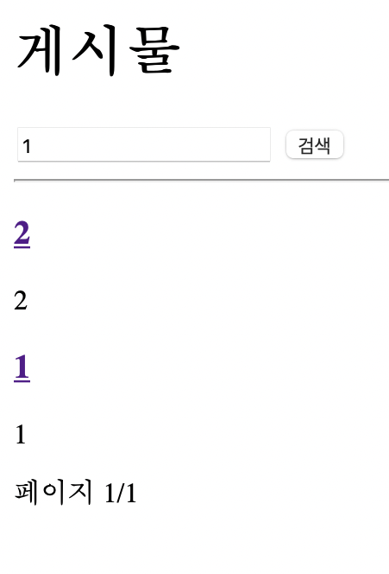
blog
localhost/blog

Slide 18
실습1
조회수 기능 추가

Slide 19
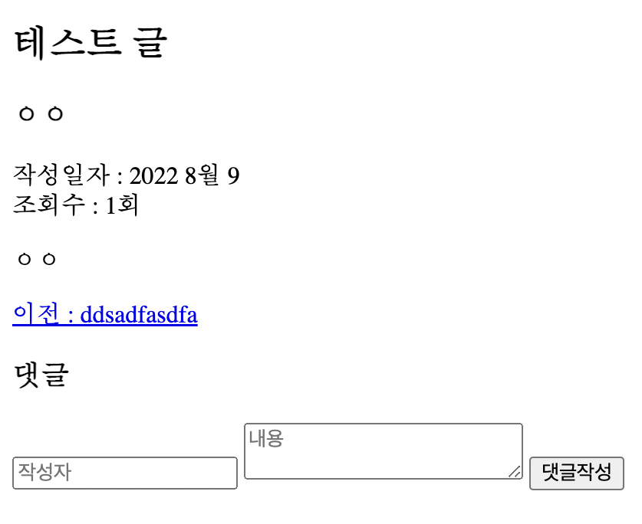
실습1
localhost/blog/post/테스트-글

Slide 20
실습1
helloworld/blog/models.py
view = models.IntegerField('조회수', default=0)

Slide 21
실습1
python manage.py makemigrations
python manage.py migrate

Slide 22
실습1
helloworld/blog/templates/blog/post_detail.html
<br> <span>조회수 : {{post.view}}회</span>

Slide 23
실습1
helloworld/blog/views.py
class PostDV(DetailView): def get_context_data(self, **kwargs): context = super(PostDV, self).get_context_data(**kwargs) context['post'].view += 1 context['post'].save() return context

Slide 24
실습2
polls -> 클래스형 뷰

Slide 25
세션
서버
Request
Response
브라우저

Slide 26

세션
서버
Request
Response
브라우저

Slide 27
세션
서버
브라우저

Slide 28
세션
서버
브라우저
abc

Slide 29
세션
저장소
서버
브라우저
aaa
………
abc
1234567
abc
hi
………

Slide 30
세션
서버
브라우저
abc

Slide 31

세션
서버
브라우저
abc

Slide 32
세션
서버
브라우저
abc

Slide 33
blog
helloworld/blog/views.py
class CommentAdd(CreateView): def post(self, request, *args, **kwargs): request.session['writer'] = request.POST.get('writer') return super(CommentAdd, self).post(request, *args, **kwargs)

Slide 34
blog
helloworld/blog/views.py
class PostDV(DetailView): def get_context_data(self, **kwargs): context = super(PostDV, self).get_context_data(**kwargs) context['post'].view += 1 context['post'].save() context['writer'] = self.request.session.get('writer', '') return context

Slide 35
blog
helloworld/blog/templates/blog/post_detail.html
<input type="text" name="writer" placeholder="작성자" value="{{writer}}" />

Slide 36
실습3
조회수 중복 방지!

Slide 37
실습3
helloworld/blog/views.py
class PostDV(DetailView): model = Post template_name = 'blog/post_detail.html' context_object_name = 'post' def get_context_data(self, **kwargs): context = super(PostDV, self).get_context_data(**kwargs) if self.request.session.get('read-' + str(context['post'].id), True): context['post'].view += 1 context['post'].save() self.request.session['read-' + str(context['post'].id)] = False context['writer'] = self.request.session.get('writer', '') return context

Slide 38
자바스크립트
웹 브라우저에서 작동하는 언어!

Slide 39
자바스크립트
javascript != java

Slide 40
자바스크립트
<body> <script> document.addEventListener('DOMContentLoaded', function () { document.getElementById('hi').innerText = 'Hello World!'; }) </script> <h1 id="hi"></h1> </body>

Slide 41
자바스크립트
DOMContentLoaded

Slide 42
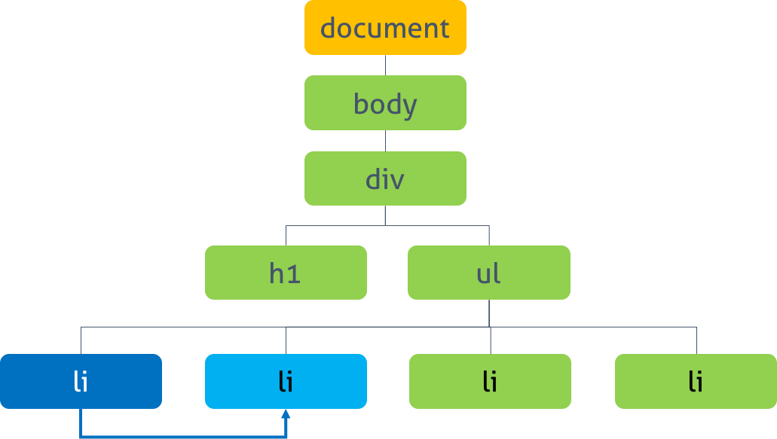
자바스크립트
DOM

Slide 43
자바스크립트
DOM
<body> <script> document.getElementById('hi').innerText = 'Hello World!'; </script> <h1 id="hi"></h1> </body>

Slide 44
자바스크립트
DOM
<body> <script> document.getElementById('hi').innerText = 'Hello World!';
로드 중…

Slide 45
자바스크립트
DOM
<body> <script> document.addEventListener('DOMContentLoaded', function () { document.getElementById('hi').innerText = 'Hello World!'; }) </script> <h1 id="hi"></h1> </body>

Slide 46
자바스크립트
<script> let i = 2; document.addEventListener('DOMContentLoaded', function () { document.getElementById('hi').innerText = i * 2; }) </script>

Slide 47
자바스크립트
<script> let i = 2; document.addEventListener('DOMContentLoaded', function () { let elem = document.getElementById('hi'); elem.innerText = i * 2; }) </script>

Slide 48
자바스크립트
<style> .test { background: red; } </style>
<script> document.addEventListener('DOMContentLoaded', function () { let elem = document.getElementById('hi'); elem.innerText='Hello World!'; elem.classList.add('test'); }) </script> <h1 id="hi"></h1>

Slide 49
자바스크립트
<script> document.addEventListener('DOMContentLoaded', function () { let elem = document.querySelector('ul'); for (let li of elem.querySelectorAll('li')) { li.innerText = 'hi' } }) </script> <ul> <li></li> <li></li> <li></li> <li></li> </ul>

Slide 50
자바스크립트
<script> document.addEventListener('DOMContentLoaded', function () { let elem = document.querySelector('ul'); for (let i = 0; i < 4; i++) { let li = document.createElement('li'); li.innerText = 'item' + i; elem.appendChild(li); } }) </script> <ul></ul>

Slide 51
blog
helloworld/blog/urls.py
path('search/', views.PostSearch.as_view(), name='index'),

Slide 52
blog
helloworld/blog/views.py
class PostSearch(ListView): model = Post template_name = 'blog/post_search.html' context_object_name = 'posts' paginate_by = 2 def get_queryset(self, *args, **kwargs): qs = super().get_queryset(*args, **kwargs) query = self.request.GET.get('q') if query: return qs.filter(title__contains=query) return qs

Slide 53
blog
helloworld/blog/templates/blog/post_search.html
<hr> {% for post in posts %} <a href="{{post.get_absolute_url}}"><h3>{{post.title}}</h3></a> <p>{{post.description}}</p> {% endfor %}

Slide 54
blog
helloworld/blog/templates/blog/post_list.html
<div id="list"> <hr> {% for post in posts %} <a href="{{post.get_absolute_url}}"><h3>{{post.title}}</h3></a> <p>{{post.description}}</p> {% endfor %} </div>

Slide 55
blog
helloworld/blog/templates/blog/post_list.html
<script> document.addEventListener('DOMContentLoaded', function () { let search = document.getElementById('search'); search.addEventListener('input', function () { fetch('/blog/search?q=' + search.value).then(res => res.text()).then(html => { document.getElementById('list').innerHTML = html; }) }) }) </script>

Slide 56



자바스크립트

Slide 57
자바스크립트
https://learnjs.vlpt.us/

Slide 58
실습4
커뮤니티 구현!

Slide 59
실습4
Post
id
integer, AutoIncrement, PK
content
TextField, 내용
title
varchar(50), 제목
create_dt
dateTimeField, 작성일자
slug
Slug, unique, 주소
modify_dt
dateTimeField, 수정일자
description
varchar(100), 부제목

Slide 60
실습4
Post
Comment
id
integer, AutoIncrement, PK
content
TextField, 내용
post
Post(Foerign Key), 달린 글
create_dt
dateTimeField, 작성일자
writer
varchar(50), 작성자

Slide 61
실습4
Post
Comment
Account
Board
id
integer, AutoIncrement, PK
id
integer, AutoIncrement, PK
???
???
???
???

Slide 62
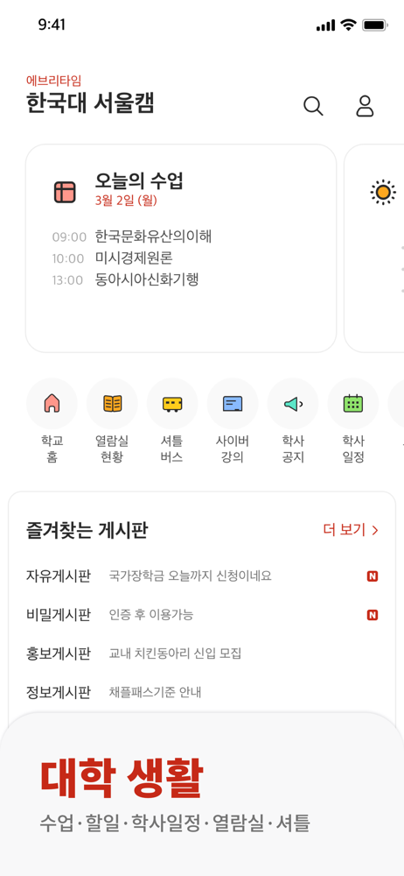
실습4
Post
Comment
Account
Board

Slide 63
실습4
Post
Comment
Account
Board

Slide 64
실습4
Board
Post
Comment
Account

Slide 65
실습4
Account
로그인
회원가입
Board
메인 페이지
Post
게시글 목록
게시글 보기
게시글 작성
게시글 삭제
Comment
댓글 작성
댓글 삭제

Slide 66
실습4
로그인
댓글 작성
댓글 삭제
게시글 작성
게시글 삭제

Slide 67
실습4
본인 확인
댓글 삭제
게시글 삭제

Slide 68
실습4
함수형 뷰 vs 클래스형 뷰

Slide 69
Goodbye World!
https://github.com/HancomAC/django

Slide 70
웹 프로그래밍
한글과컴퓨터학원
조교 이서현

